Slide 1
LLM-Elicted Bayesian Predictor
Presenter: Seongwon Yun
© 2025 Hanwha Life

Slide 2
Contents
Goal
Eliciting Bayesian Priors
Idea
Validation
Dashboard
Usage Case
Research Ideas
Conclusion

Slide 3
References
- Capstick, A., Krishnan, R. G., & Barnaghi, P. (2025). AutoElicit: Using large language models for expert prior elicitation in predictive modelling (ICML 2025).

Slide 4
Goal
- Use LLM for prediction.
- Incorporate expert knowledge.
- Provide useful feedback to the user (e.g. executives).

Slide 5
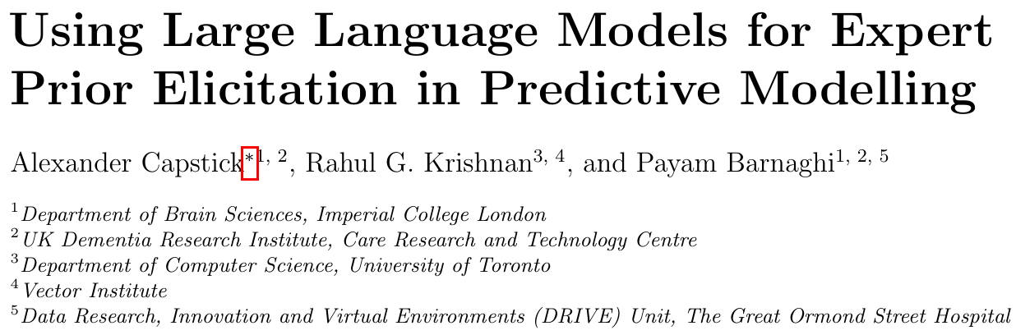
Eliciting Bayesian Priors

Slide 6
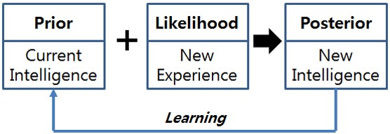
Eliciting Bayesian Priors

Slide 7
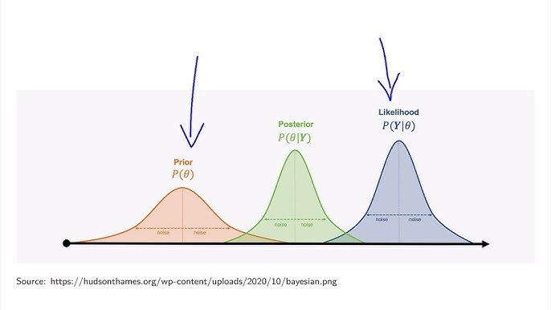
Eliciting Bayesian Priors

Slide 8
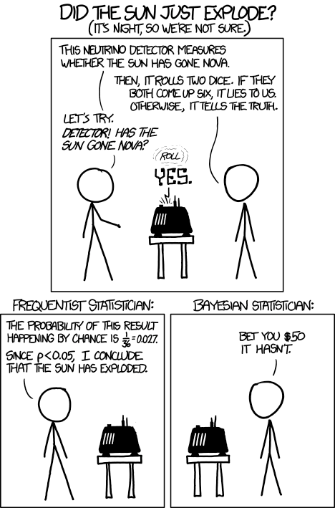
Eliciting Bayesian Priors

Slide 9
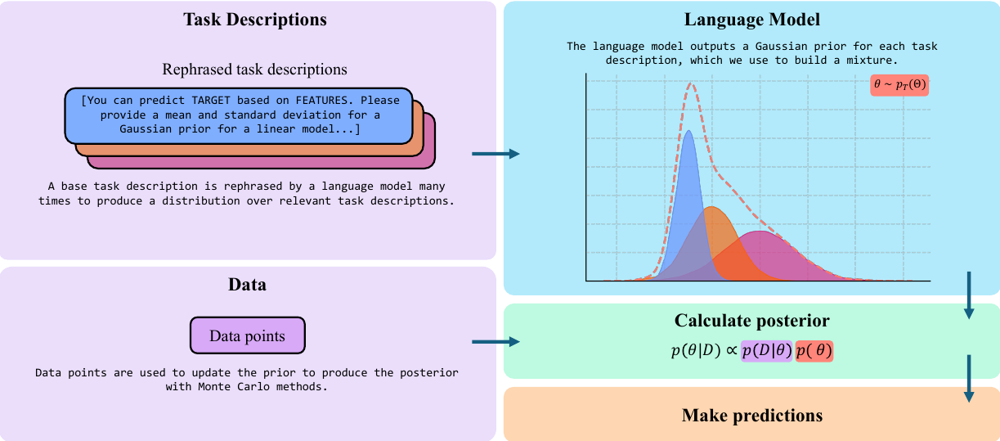
Eliciting Bayesian Priors

Slide 10
Idea
Create an agent such that
- through conversation, choose predictor variables.
- inject expert priors, or use uninformed priors, or (with a well-knowledgeable agent) elicit priors from LLM.
- use Bayesian linear regression to fit the data.
As for prediction,
- Use the user’s scenarios to generate (point or distributional) predictor values. Alternatively, recent data could be utilized instead.

Slide 11
Idea
Benefits:
- Explainability to executives
- Scenario analysis
- Obviously better than naive LLM prediction
Novelty:
- Multivariate prior generation.
- Prediction based on expert scenarios (z|beta ~ N(expert_prior, tau))
- News as a latent variable approach with LLM-generated priors.

Slide 12
Validation
Data Used:
- Target Variable: Monthly stock return of Hanwha Solutions
- Predictor Variables: 5 features (kospi_return, oil_price_change, usd_krw_change, vix_change, materials_sector_return)
- Train Data: 2022-07 – 2024-12
- Test Data: 2025-01 – 2025-06

Slide 13
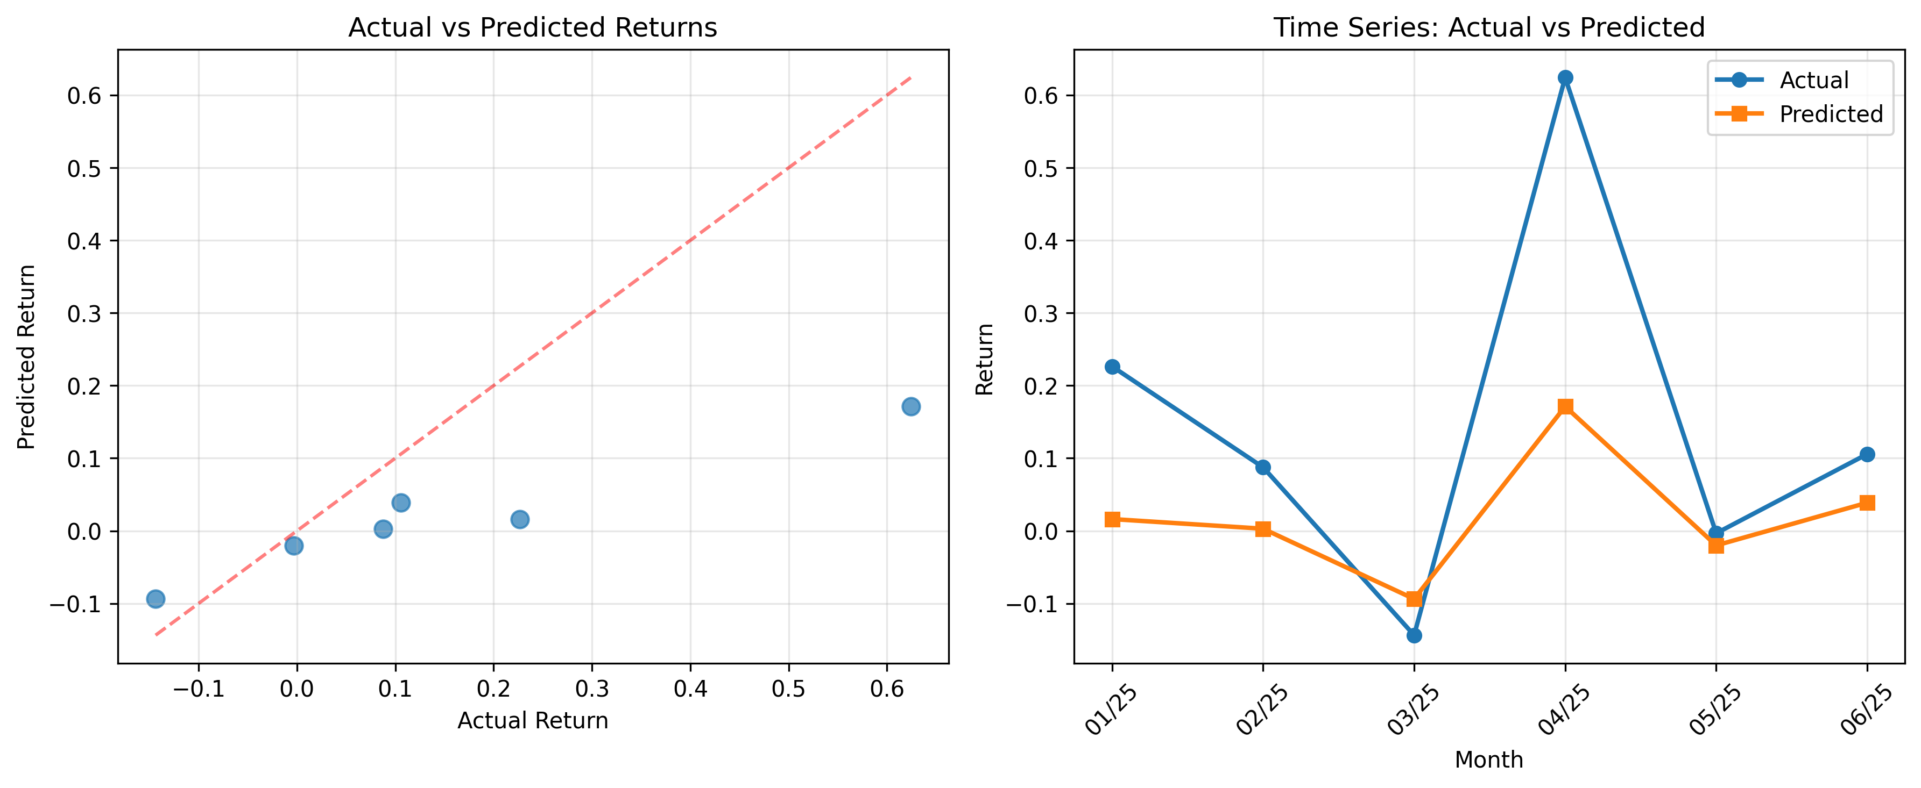
Validation

Slide 14
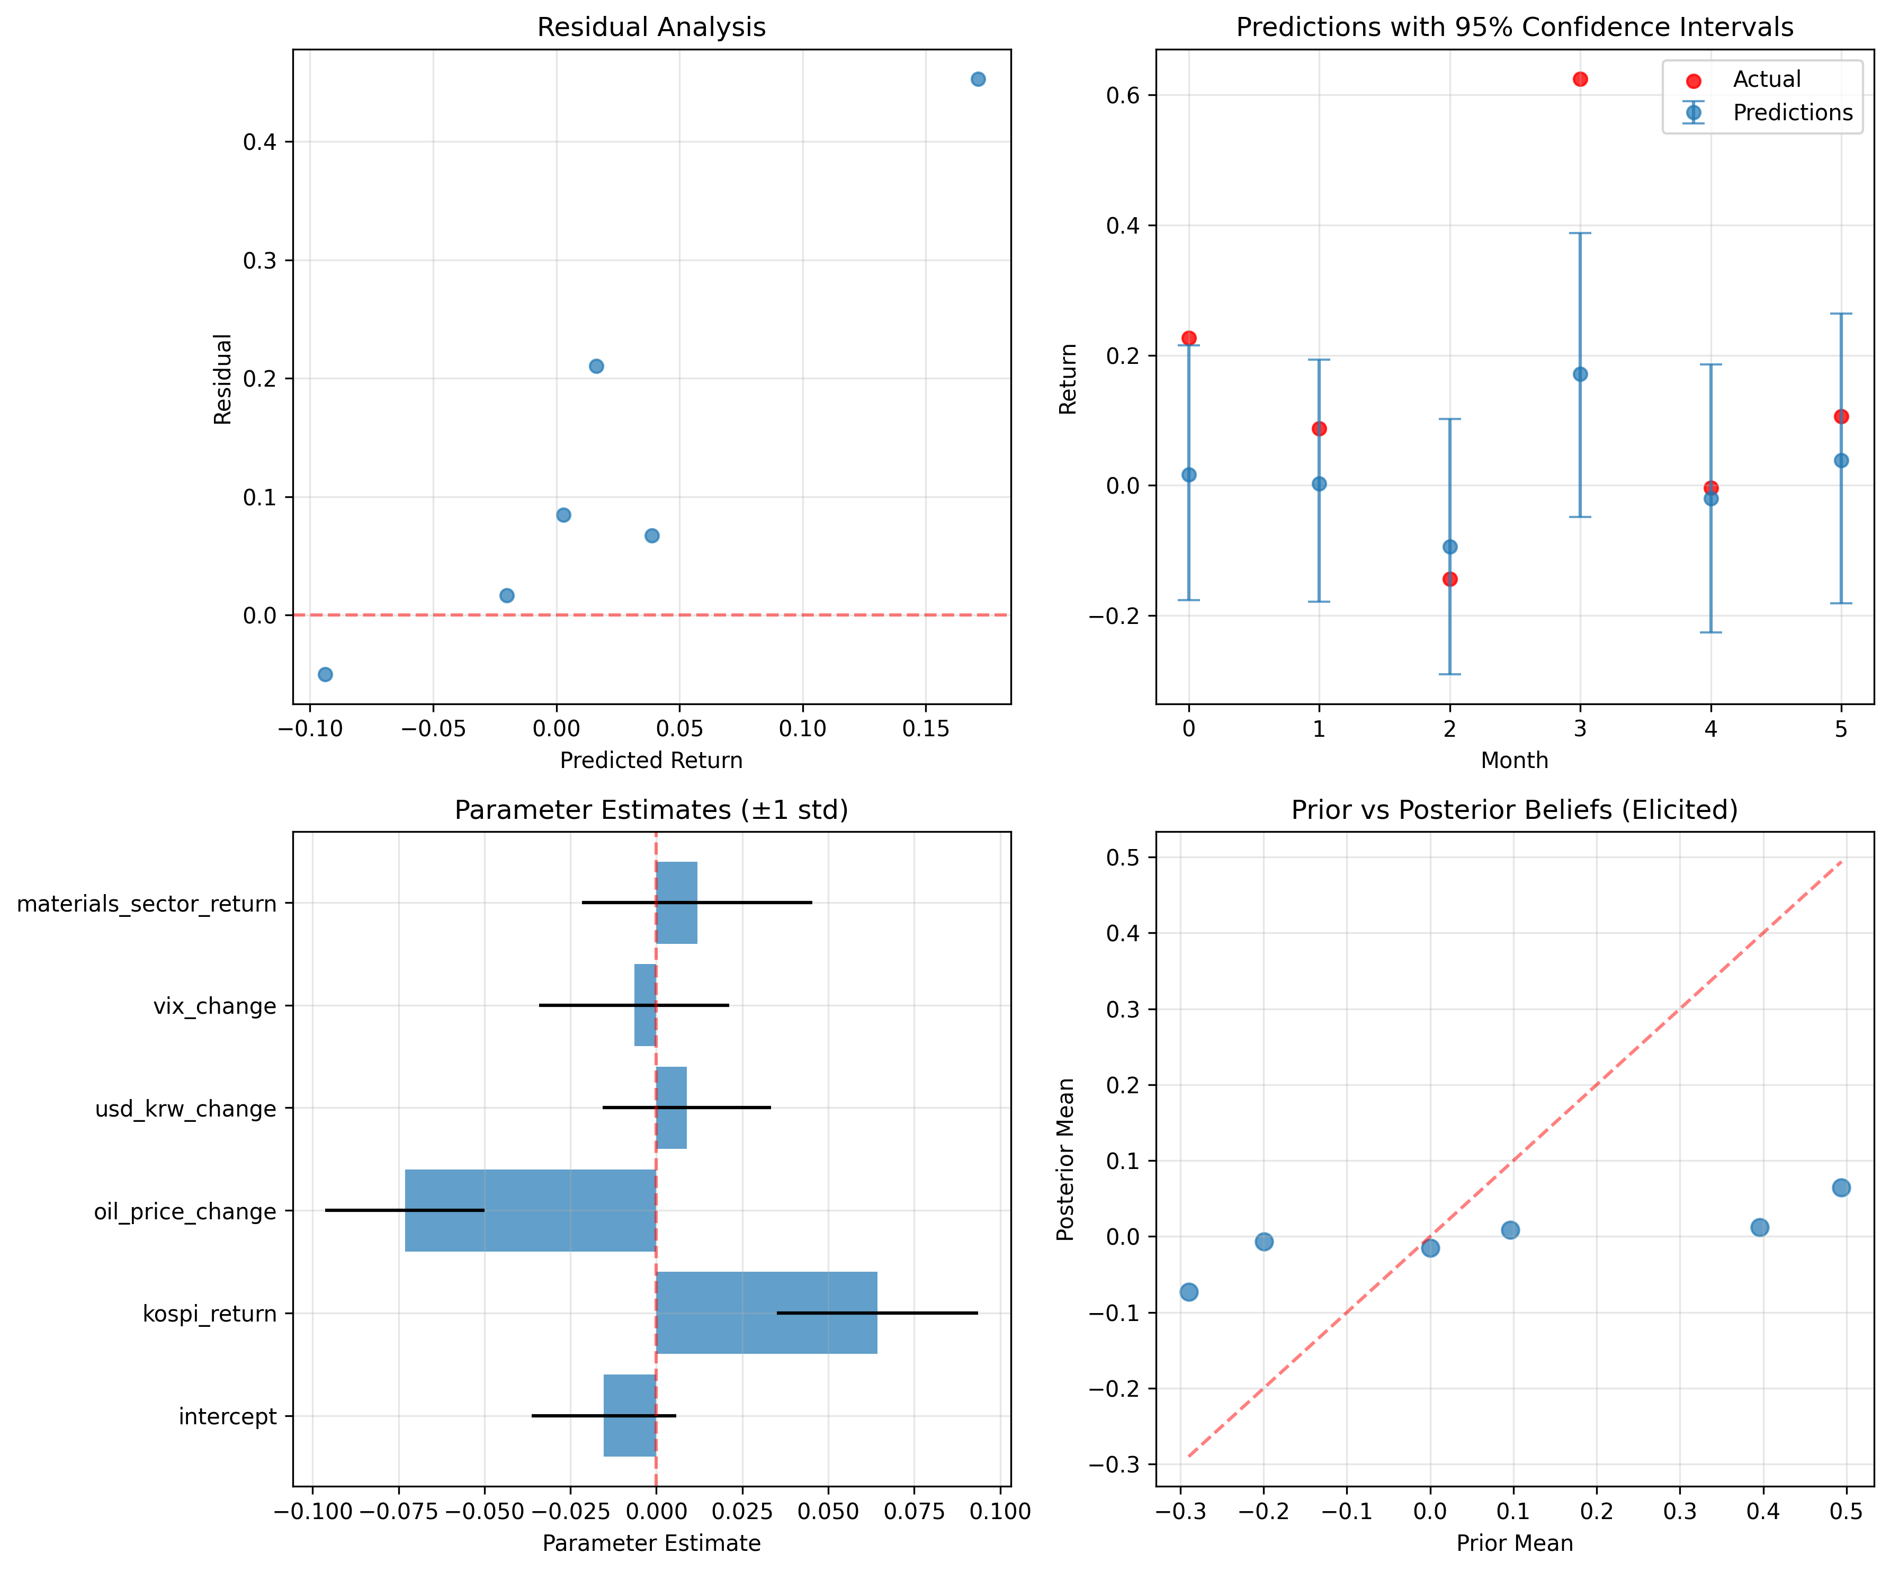
Validation

Slide 15
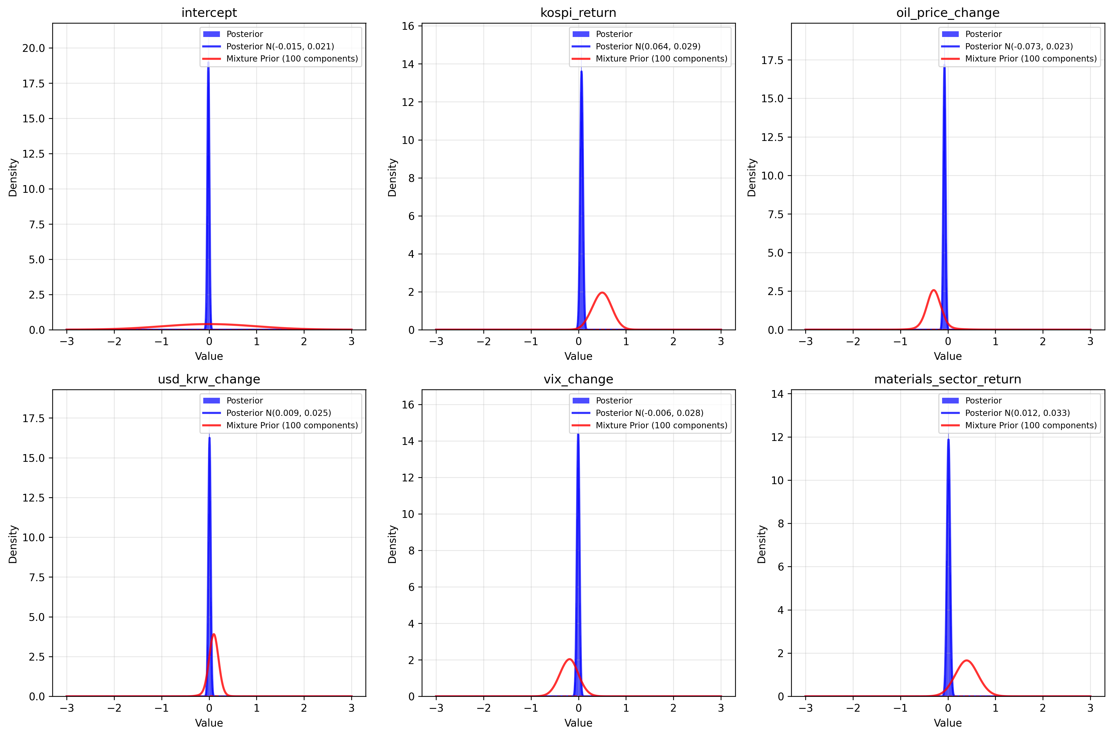
Validation

Slide 16
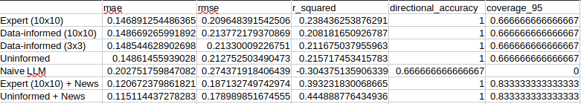
Validation

Slide 17
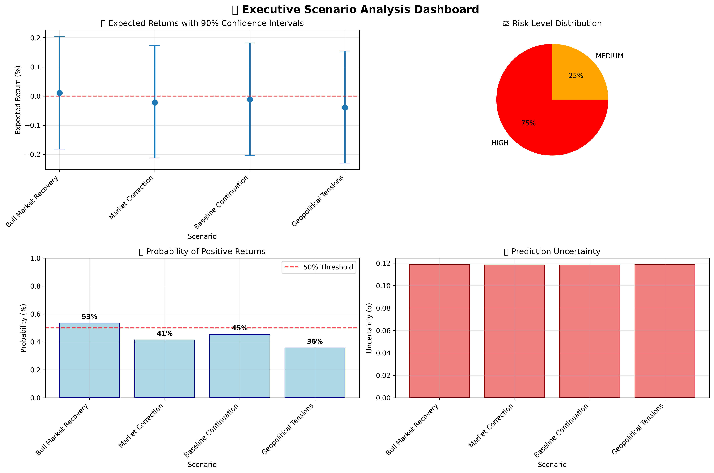
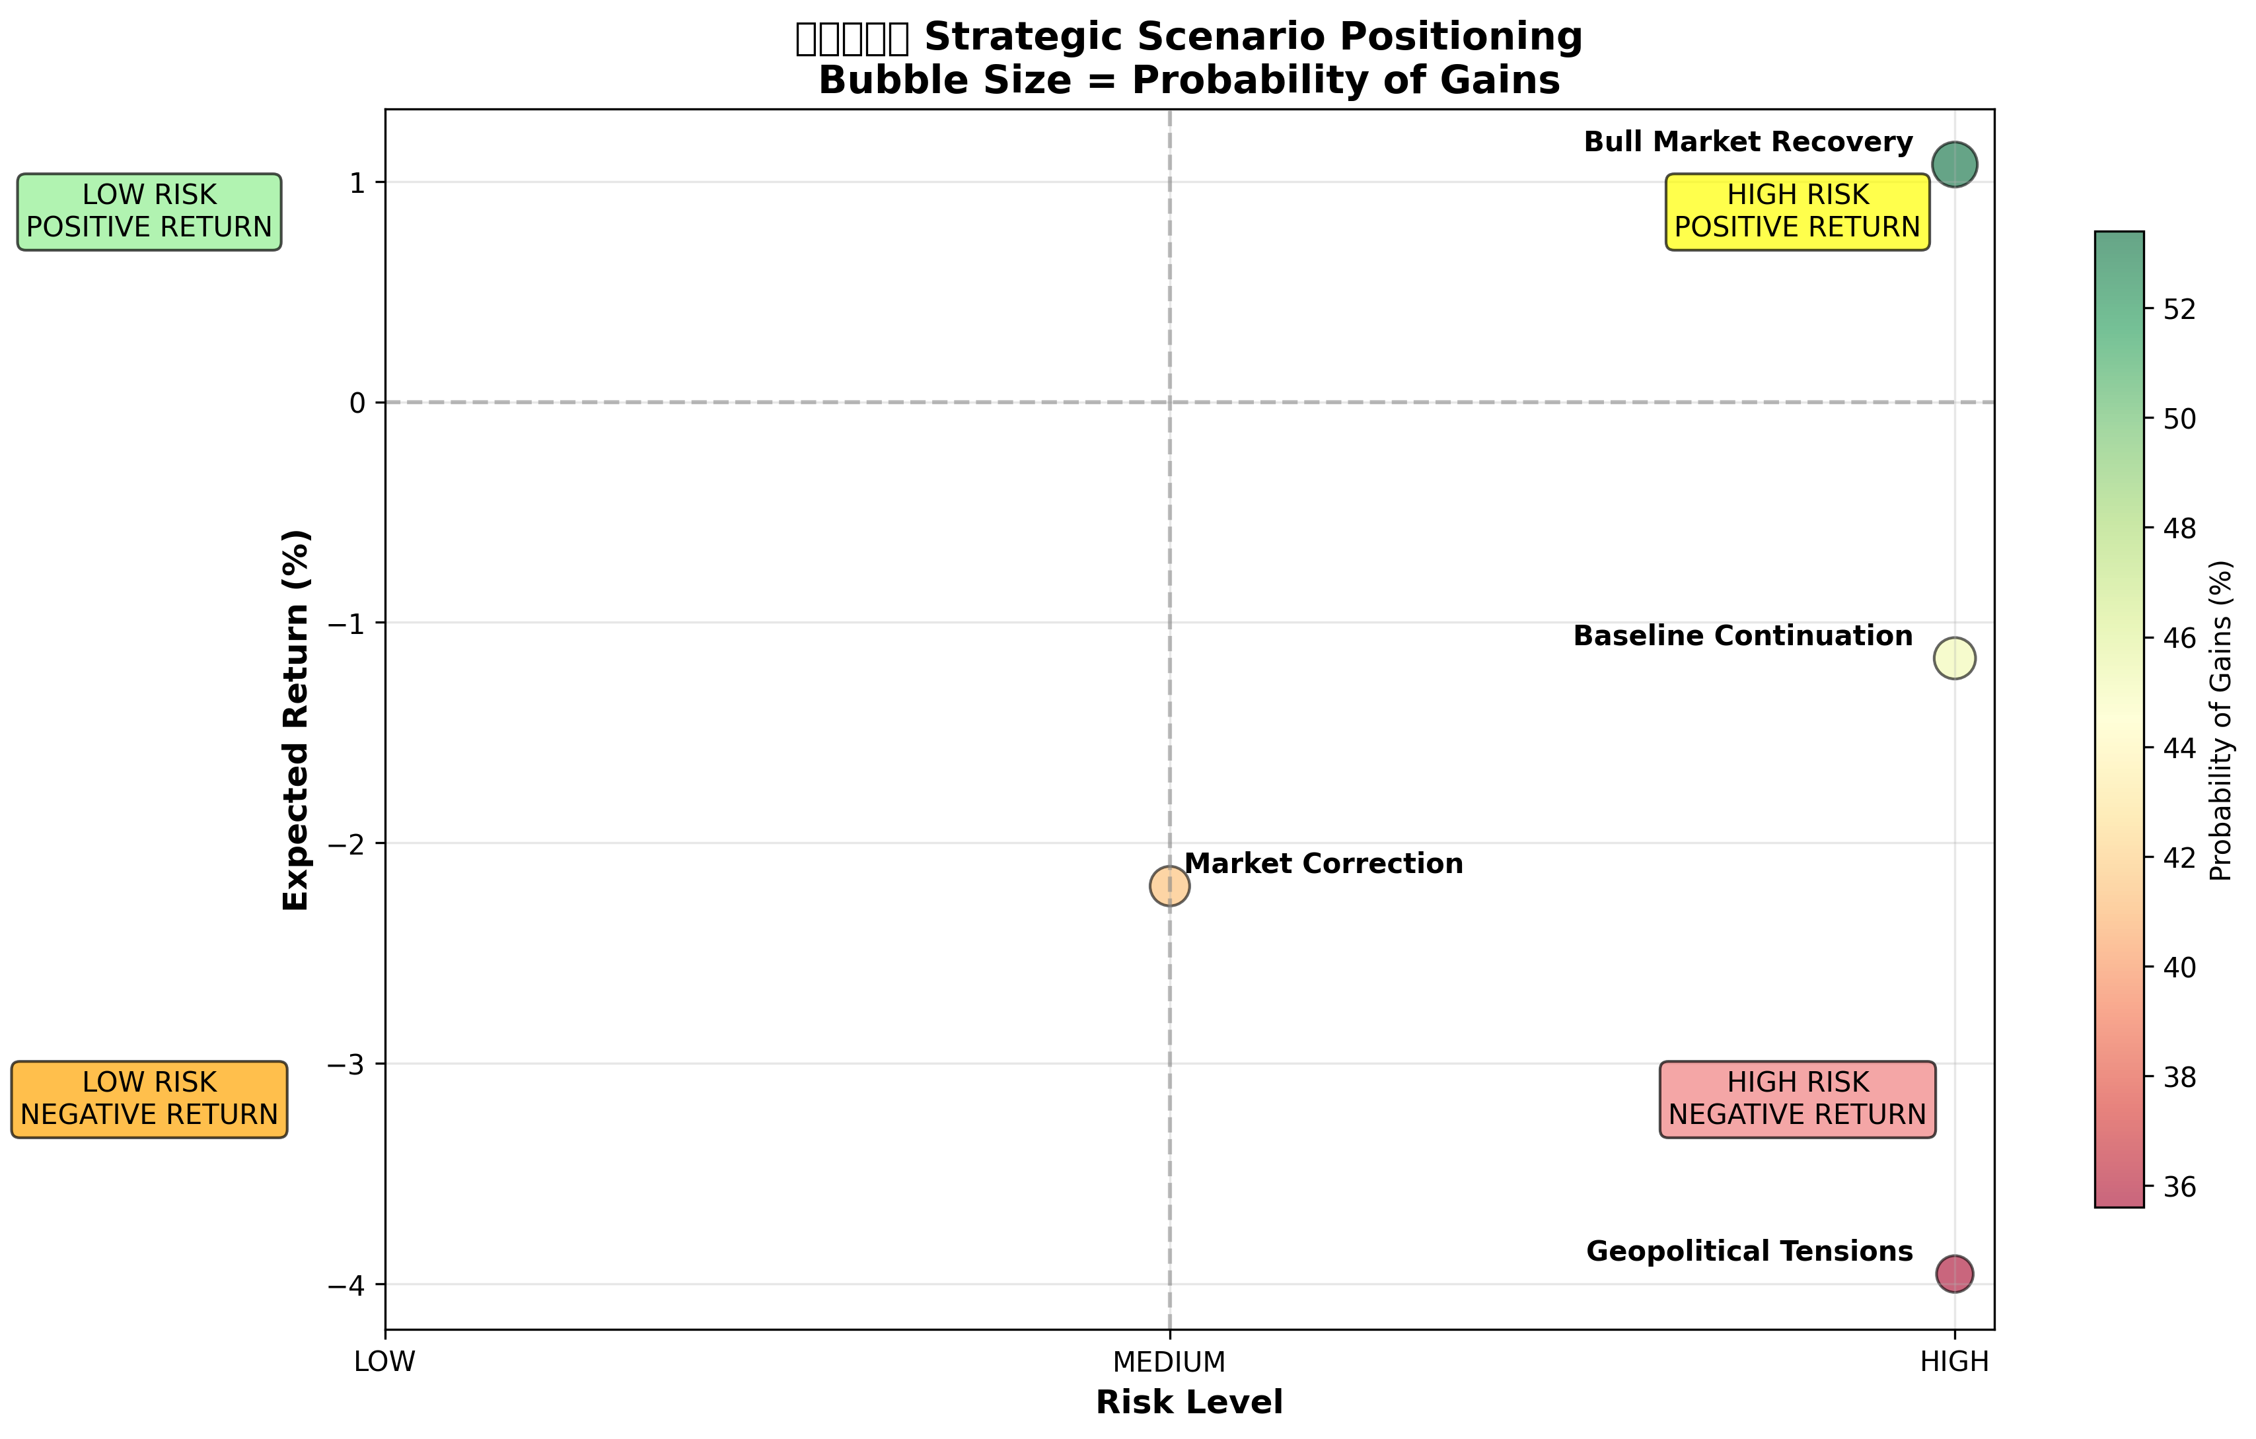
Dashboard

Slide 18
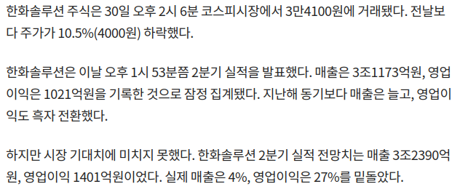
Usage Case

Slide 19
Usage Case
- Use uninformed/expert priors.
- Expert creates scenarios, or recent data could be used as the predictor variables.
Key point is we could technically use July data as the predictor variable as long as it is before the official announcement for the accounting data.
- Expert discusses with the LLM with different scenarios, its plausibility, and so on.
- Profit.

Slide 20

Idea: Incorporating Expert’s Scenarios
Predictor variable distribution into predictive distribution:
(e.g. kospi_return is likely to decrease by 0.5% next month, but if event A happens – which I think is quite unlikely – it will increase by a fair margin):
News or RAG-based agent could potentially be used to generate such a distribution as well with autoelicit.

Slide 21
Idea: Incorporating Expert’s Scenarios
Now different beta relationship offered by experts:
(e.g. So far kospi_return had positive impacts on the target variable, but I believe the relationship will turn around starting from next week)

Slide 22
Idea: Incorporating Expert’s Scenarios
Or, regarding expert opinion as another data source,
Then the posterior (e.g. beta_oil) becomes

Slide 23

Idea: News as a Latent Variable
Y = X\beta + \epsilon
Y = X\beta + delta_t + \epsilon
Generate mixture priors for each delta_t based on the collected news:
(Q. Macro factors already explain the systematic part of Hanwha Solutions' return. Based on the news below, state your Gaussian PRIOR (mean, std) in percentage points for the idiosyncratic return α_news this month.)
Likelihood: p(y | beta, sigma, delta) = prod_t p=(y | beta, sigma, delta_t)

Slide 24

Idea: News as a Latent Variable
Now we want to predict y*. We derive the mixture distribution for delta* as well, then

Slide 25
Conclusion
LLM contribution via
- LLM-elicited prior
- expert writings into various distributions (e.g. data, opinion)
- news priors by an expert agent
- as a frontend
Interaction with experts
Explainability to executives (scenario-based)

